Slide 1
7th Literature
Whom do you feel CLOSEST to you?

Slide 2
Poetic Form: Line and Stanza

Slide 3
line
the main unit of a line

Slide 4
stanzas
similar to a paragraph in a prose
group of two or more lines that form longer units within a poem

Slide 5
Text Analysis: Rhyme Scheme

Slide 6
sound device
Ways of using words for the sound qualities they create
Help convey meaning and mood in a writer’s work

Slide 7
sound device
Common sound devices
Alliteration
Assonance
Meter
Onoatopoeia
Repetition
Rhyme
Rhythm

Slide 8
rhyme
the repetition of sounds at the end of words

Slide 9
rhyme scheme
the pattern of rhyme at the end of lines in a poem
Poets use a rhyme scheme to help them create meaning and emphasis.

Slide 10
And this was the reason that, long ago a
In this kingdom by the sea b
A wind blew out of cloud by night c
Chilling my Annabel Lee b

Slide 11
Just before you turn on the tv
With my friends I could talk,
Read a book, take a walk–
There’s so much my ought to __________!

Slide 12
Just before you turn on the tv
With my friends I could talk,
Read a book, take a walk–
There’s so much my ought to see!

Slide 13
Reading Skill: Understand Speaker

Slide 14
speaker
the “voice” that talks to the reader
The speaker is not necessarily the poet.
To understand a poem, you have to identify the speaker and his or her attitude toward the subject.

Slide 15
couplet
a stanza of two rhyming lines

Slide 16
repetition
the repeating of a sound, word, phrase, or line to emphasize an idea

Slide 17
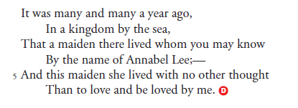
Annabel Lee
What is the rhyme scheme?

Slide 18
Annabel Lee
What is the rhyme scheme?
ababcb

Slide 19
End!

