Slide 1
Dallas Winston (Dally)
The Outsiders

Slide 2
Physical Traits
Name: Dallas Winston or Dally
Boy
Elfish face
Eyes so blue, blazing ice, cold with hatred of the whole world
Lynx ears
High cheekbones
Small, sharp animal teeth
Pointed chin
Long hair
Hair almost white/ so blond
Hair fell over his forehead and wisps and kicked back and curled behind his ears and along the nap of his neck

Slide 3
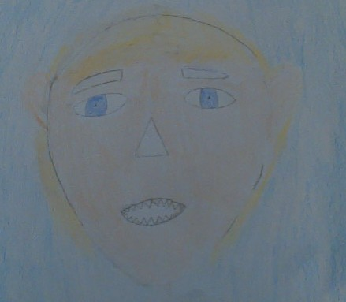

Slide 4
Character Traits
Arrested at the age of 10
Spent 3 years on the wild side of New York
Tougher than everyone tuffer, colder, meaner
He was as wild as the boys in downtown outfits, dressed like Tim Shepard's gang
In New York blew off steam gangs fights
Doesn’t like haircuts or hair oil

