Slide 1
Darry
Kole,Kirsten,Tanner

Slide 2
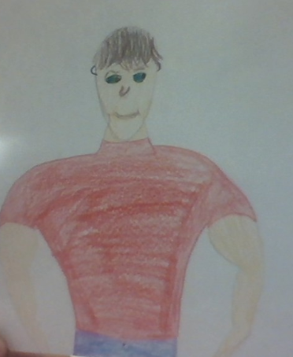

Slide 3
Darry
Important Info
~20 yrs old but looks older
~Works long hours as a roofer
~Oldest of the three brothers
~Looked like his father
~Was captain of his football team
~Turned down athletic scholarships
~ Goes skiing with his friends once a year

Slide 5
Darry
Description of character
*Oldest of three brothers
*20 years old
*Works as a roofer
*He was often grumpy

Slide 6
Character traits
Tough, cool, smart
He does not understand anything that isn’t plain hard fact
Hard on Ponyboy
Hard worker

Slide 7
The End!!!

